Slide 1

SKYTRAX AIRLINE REVIEW ANALYSIS
Rounak Saha
28/01/2025

Slide 2
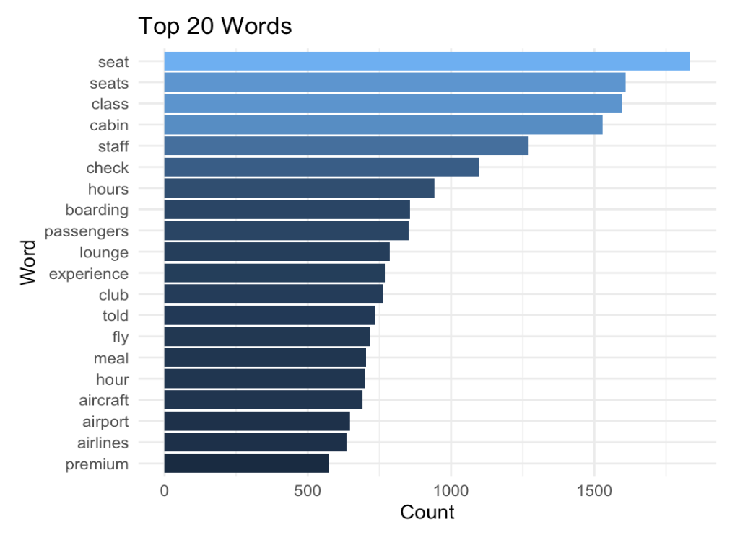
RESULTS
Key Topics
The frequency chart below shows that the key topics within the reviews
include “class”, “seat”, “boarding” and “staff”, showing that people
are actively talking about their experience and staff.
Sentiment
Out of 3000 reviews, 42% were positive, 36% were negative and 22% were neutral.
This means the majority of reviews were polarised as either positive or negative.
42%
Positive
36%
Negative
22%
Neutral

